Slide 1
Hiking The Path To Student Loans And Credit
10.13.2015
Lyssa L. Thaden, Ph.D., AFC®, Manager of Partner Education
Notes:
Student Loans and Credit: An Overview
Borrowing student loans is a fact of life for many students. The use of credit cards often quickly follows. While these aren’t bad actions in and of themselves, understanding how borrowing impacts credit – and how credit impacts other areas of your financial life – is an often missed step in the process. Join this session as we walk through the basics of credit reports and scores – and how student loans and credit cards fit in to the credit picture. Then, join your colleagues in discussion for building best practices on how to help educate your students along their academic and financial journey.

Slide 2
Agenda
Borrowing realities
Credit reports and scores
Student loan and credit card impact
Conversation and best practices for student education

Slide 3
Borrowing Realities

Slide 4
Student Debt
It’s easy for students to get overburdened.
70%
The Class of 2013 is the most indebted ever with 70% of graduates carrying an average debt of $35,200¹
1. “Cost-Conscious College Graduates: A Study of Recent College Graduates.” Fidelity Management and Research LLC. 2013.

Slide 5
Your Students
Average student loan debt
  Does this vary by program or other variable?
Credit card usage
  How many of your students pay for tuition via credit card?
  Troubling trends?
Other consumer debt
  Car loans
  Rent-to-own
  Payday loans

Slide 6
Credit Reports & Scores

Slide 7
Credit Defined
“Contractual agreement whereby a borrower (e.g. consumer) receives something of monetary value now in agreement to repay the lender (e.g. Visa or Sallie Mae) at a future date. Once credit has been accepted, it becomes debt.”
- Institute for Financial Literacy, 2010
Notes:
We should start by defining what Credit is. This definition is fairly straightforward and comes from the Institute for Financial Literacy.

Slide 8
Types Of Credit
Secured credit
  Backed by an asset
  Mortgages, auto loans, equity lines of credit
Unsecured credit
  No collateral or asset backing
  Credit cards (most), store charge cards, student loans and personal loans
Notes:
Generally speaking, credit can be secured or unsecured. Secured credit is backed by some type of asset or collateral. If the borrower does not meet their end of their agreement with paying back money, they risk losing collateral. Unsecured credit means that there is no collateral or assets backing the loan or money that has been lent out. This is one of the reasons interest rates tend to be higher on unsecured credit.

Slide 9
Types Of Credit
Installment Loans | Revolving Lines of Credit
Specified amount of money is borrowed | Agreement by lender (e.g. bank, credit union) to lend specified money
Purpose and repayment terms are both defined | Money can be accessed at any time to pay for anything
Each payment reduces loan balance and loan is closed when balance reaches zero | As payments are made on balance, that amount frees up for more spending
Examples: Car Loan, mortgage, student loans | Examples: Credit cards, store charge cards, lines of credit
Institute for Financial Literacy, 2010
Notes:
When we talk about types of credit, it is important to distinguish between Installment Loans vs. Revolving Lines of Credit. The table in this slide highlights the major similaritites and differences between these two types of credit.

Slide 10
Fixed/Adjustable Interest Rates
Fixed interest rate
  Stays the same for the life of the loan
Adjustable interest rate
  Changes with certain factors
    Check when it changes (monthly, yearly)
    Check what the interest rate is based on (e.g. LIBOR + 2%)

Slide 11
Good Debt Vs. Bad Debt
Good Debt
Student Loans
Bad Debt
Credit Card Debt
Car Loan
Consumer Loan
----------------------
Mortgage
Business Loan
----------------------
Repayment Plan
Tax Deductible
Notes:
In general, good debt is debt that you take on as an investment of sorts – whether that is in yourself in the form of an education, a home, or a business. These loans tends to come with a structured repayment plan and have tax deductions associated with them.
Bad debt tends to be riskier – and immediately has a significant negative cost – whether that is a high interest rate, variable terms, or the fact that you are simply buying something you don’t “need” on credit.

Slide 12
Credit Reports
Personal information
Credit history
  Amount borrowed
  Credit limit
  Payment history
  Delinquencies
Public records
Inquiries
Notes:
A credit report is like a report card – but instead of measuring your success in class, this measures your success with credit and debt. These are the four main categories that you will see on your credit report.

Slide 13
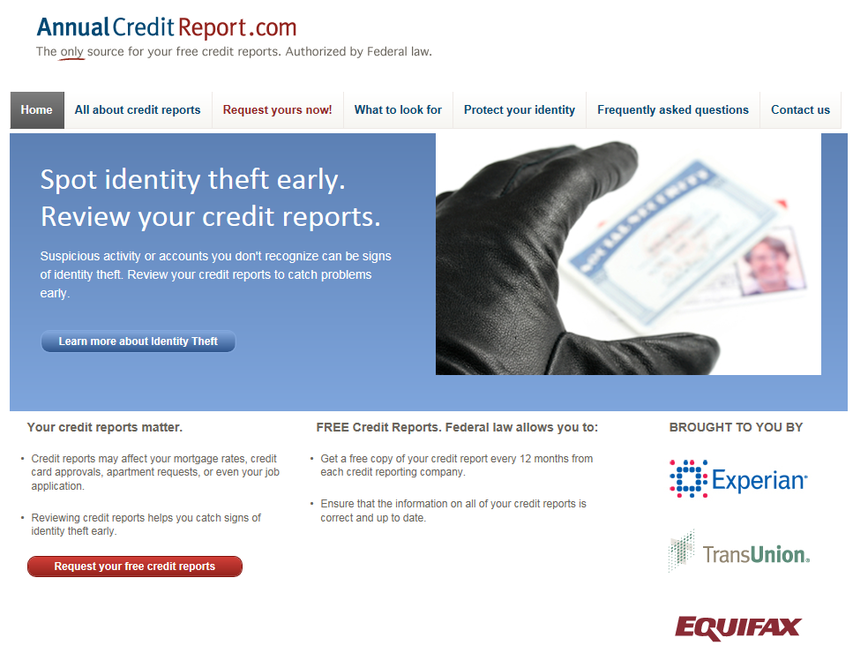
Get Your Reports!
Notes:
www.annualcreditreport.com is the free source for your credit report for the three main credit bureaus – Experian, Equifax and TransUnion.

Slide 14
Your FICO® Score
Notes:
Your credit score is derived from information on your credit report. The five most important areas that are reviewed are payment history, amounts owed, length of credit history type of credit used and new credit.
From www.myfico.com
Payment History
Account payment information on specific types of accounts (credit cards, retail accounts, installment loans, finance company accounts, mortgage, etc.)
Presence of adverse public records (bankruptcy, judgements, suits, liens, wage attachments, etc.), collection items, and/or delinquency (past due items)
Severity of delinquency (how long past due)
Amount past due on delinquent accounts or collection items
Time since (recency of) past due items (delinquency), adverse public records (if any), or collection items (if any)
Number of past due items on file
Number of accounts paid as agreed
Amounts Owed
Amount owing on accounts
Amount owing on specific types of accounts
Lack of a specific type of balance, in some cases
Number of accounts with balances
Proportion of credit lines used (proportion of balances to total credit limits on certain types of revolving accounts)
Proportion of installment loan amounts still owing (proportion of balance to original loan amount on certain types of installment loans)
Length of Credit History
Time since accounts opened
Time since accounts opened, by specific type of account
Time since account activity
New Credit
Number of recently opened accounts, and proportion of accounts that are recently opened, by type of account
Number of recent credit inquiries
Time since recent account opening(s), by type of account
Time since credit inquiry(s)
Re-establishment of positive credit history following past payment problems
Types of Credit Used
Number of (presence, prevalence, and recent information on) various types of accounts (credit cards, retail accounts, installment loans, mortgage, consumer finance accounts, etc.)
Please note that:
A FICO score takes into consideration all these categories of information, not just one or two.
No one piece of information or factor alone will determine your score.
The importance of any factor depends on the overall information in your credit report.
For some people, a given factor may be more important than for someone else with a different credit history. In addition, as the information in your credit report changes, so does the importance of any factor in determining your FICO score. Thus, it's impossible to say exactly how important any single factor is in determining your score - even the levels of importance shown here are for the general population, and will be different for different credit profiles. What's important is the mix of information, which varies from person to person, and for any one person over time.
Your FICO score only looks at information in your credit report.
However, lenders look at many things when making a credit decision including your income, how long you have worked at your present job and the kind of credit you are requesting.
Your score considers both positive and negative information in your credit report.
Late payments will lower your score, but establishing or re-establishing a good track record of making payments on time will raise your FICO credit score

Slide 15
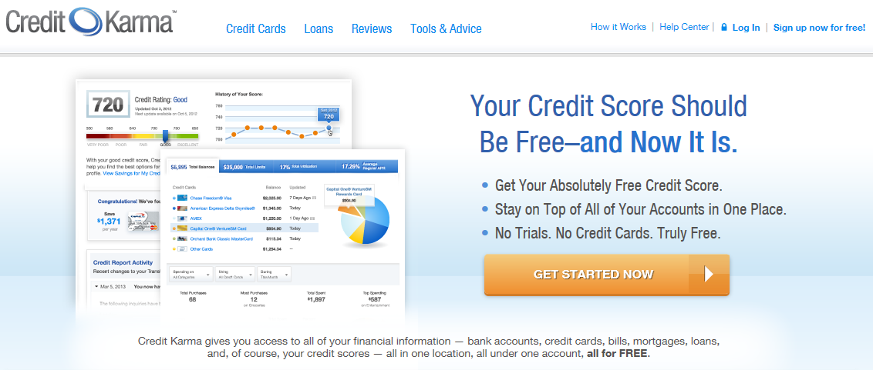
What’s Your Score?
Notes:
While FICO scores are the most commonly used, there are some other scores out on the market. And, while you’ll generally have to pay to get your FICO score (unless you’ve recently applied for credit and been denied – in which case you have to be provided with your report upon your request), you can get a couple of these other scores for free through sources like creditkarma.com. While they won’t be entirely the same score, it will give you an idea of where you would land – and what you might change to improve your scores.

Slide 16
Do Scores Matter?
Credit approval
  Including PLUS loans and private student loans
Interest rates
  Including private student loans
Insurance rates
Job opportunities
Notes:
Credit scores affect way more than your ability to get a credit card or buy a car. Your credit score determines everything from the interest rate you will pay on your line of credit, to the benefits you will receive with that line of credit, to insurance rates – and even job opportunities. Yep, employers are now checking credit reports and Facebook pages…

Slide 17
Student Loan & Credit Card Impact

Slide 18
It’s Personal!
Everyone’s personal credit situation is unique. Depending on your credit make-up, variables can differentially impact your credit score.
Notes:
Because everyone has their very own credit situation, it’s important to acknowledge that even general statements about how something may impact someone’s credit score may – or may not – be fully true for a specific individual. But, the generality of the information that follows should be a good guideline.

Slide 19
Each Loan Will Have Specific Information
Creditor Name
Creditor Address
Account Number
Date Open
Account Type
  Installment (for student loan)
Type of Loan
  Education (for student loan)
Highest Credit/Original Loan Amount
Balance
Monthly Payment
Date of Last Payment
Date Reported

Slide 20
Loan Status
Open/In good standing
Normal loan status
Closed/Paid/Zero balance
Indicates paid in full
Closed/Transferred
Indicates consolidation or reassignment
Open/Deferred until X Date
Indicates deferment/forbearance
Account past due X days
Indicates delinquent loan (30/60/90/etc.)
Claim filed with federal government
Indicates defaulted loan

Slide 21
Your FICO® Score
Notes:
Now, let’s go back to your credit score. Since your score is reflective of the items on your credit report, this is where we see the actual score play out.

Slide 22
Payment History
Are you paying on time?
Number of days delinquent?
How long since your last delinquency?
How many accounts are delinquent?
How much did you owe?
Potential Impact:
YES for all loan types
Drop (or gain) in credit score
Notes:
For any type of credit, the most important factor in your score is whether or not you are making your payment(s) on time.
If you are past due, the score will reflect the number of days delinquent you are (120 is worse than 30), and how many accounts are delinquent. If you’ve come back in to good standing, they will still be looking to see how long since your last delinquency – so it’s important to get back on track and STAY on track.

Slide 23
Amounts Owed
What is your outstanding debt?
  Total amount owed vs. original amount borrowed (for installment loan)
What is your debt to credit ratio?
What is your debt to income ratio?
Potential Impact:
YES for all loan types
Drop (or gain) in credit score
Notes:
This is a difficult piece of the puzzle to give a “simple” answer to – because it’s not just about how much you originally borrowed, but also about how much you now currently owe – and what that amount is in relationship to your overall available credit. In addition, your debt to income ratio can be used in credit determination as well. So, even if student A and student B borrowed the same amount and are on the same repayment rack, they may still have different scores based on those different ratios.

Slide 24
Length Of Credit History
How long have you had your account(s)?
Potential Impact:
YES for all loan types
Gain in credit score for additional time accounts are held
Notes:
With student loans, this is mostly reflective of “how long have you been paying” – since there really isn’t any “history” here until you start making payments – although they will start tracking upon disbursement.
With credit cards, this will be ongoing. Keeping a credit card as your “history” card can be (at least minimally) effective.

Slide 25
Type Of Credit Used
Do you have a mix of installment and/or revolving credit?
  Student loans = installment
  Credit cards = revolving
Potential Impact:
YES for all loan types
Gain in credit score for having a variety of credit types
Notes:
Student loans can actually be beneficial to a score – as it helps to diversify the credit mix (adding to a credit card only portfolio, for example).

Slide 26
New Credit
Have there been recent credit inquiries on your account?
How many recent accounts have you opened?
Potential Impact:
YES for PLUS or private loans
NO for Direct/Perkins
Possible drop in score (although minor as it relates to credit inquiries)
Notes:
Since Direct/Perkins Loans do not require a credit check, no impact.
PLUS/Private loans will result in a credit inquiry.

Slide 27
Conversation & Best Practices

Slide 28
How Are You Educating Your Students
Information touch points
  Financial aid award – yearly opportunity
  Student bills
  Graduation mailing
  Withdrawal process
Speaker series
Classroom integration
Web tools
Student group advocacy

Slide 29
Most Important Factor: Paying On Time
What education are you providing on:
  For all debt:
    The importance of on time payments
    Ways to make on time payment more likely (auto-debit, calendar reminders, etc.)
    The benefits of “good debt” and “good credit”
  For Federal student loans in particular:
    Repayment options
    Deferment/forbearance options
    Forgiveness options
    How to find who to contact and/or resources to help you

Slide 30

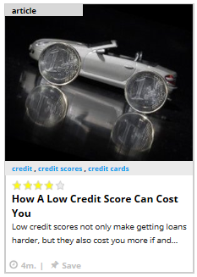

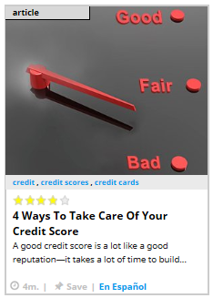
SALT Resources

Slide 31
Thank You
American Student Assistance
800.999.9080
education@asa.org
asa.org
Notes:
Recommended:
Arial font for contact info, 50% black and 12 points

