Slide 1
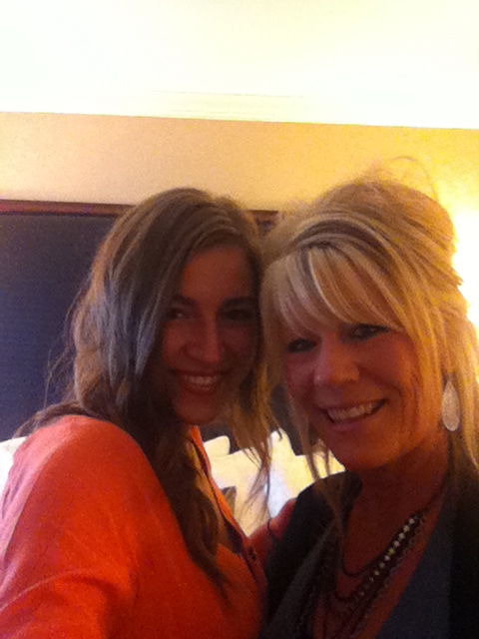
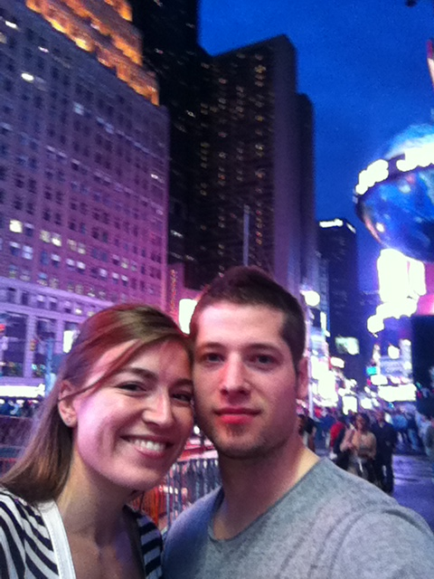
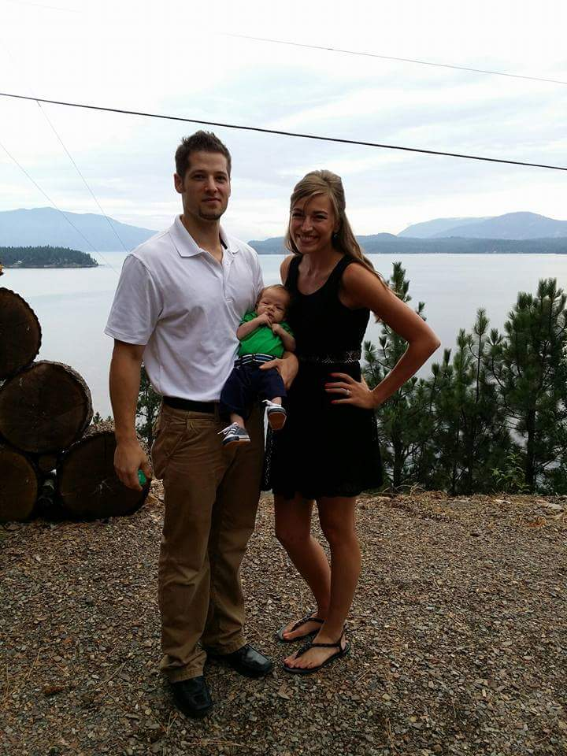
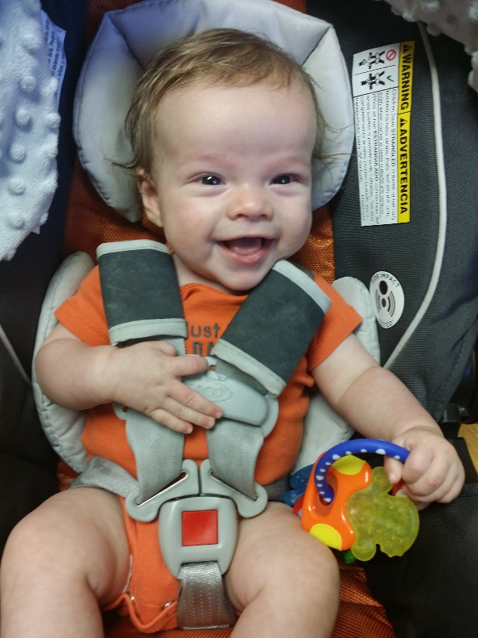
Courtney Robinson, LCSC
Played college volleyball for 2 years
Is a certified Event and Wedding Planner
Worked at Disney World for 5 months as an intern
Scholarship & Veterans Coordinator at LCSC

Slide 2
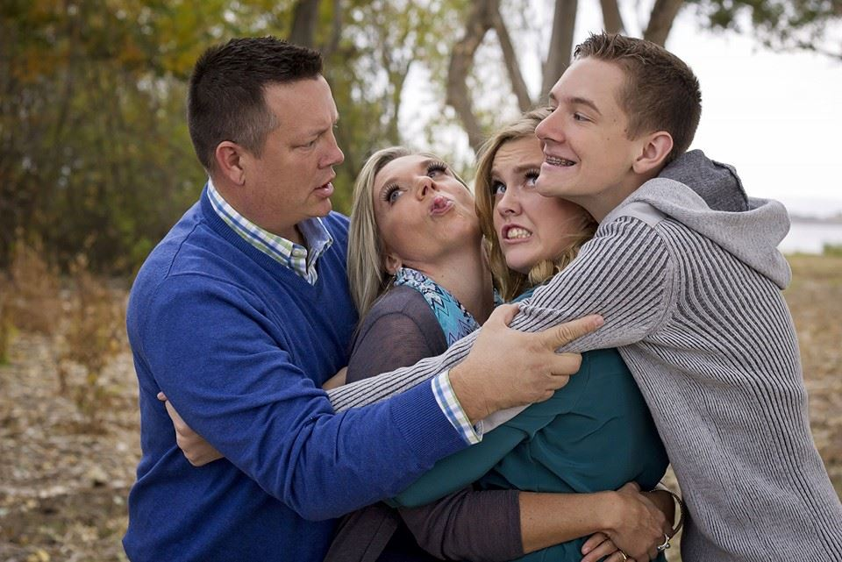
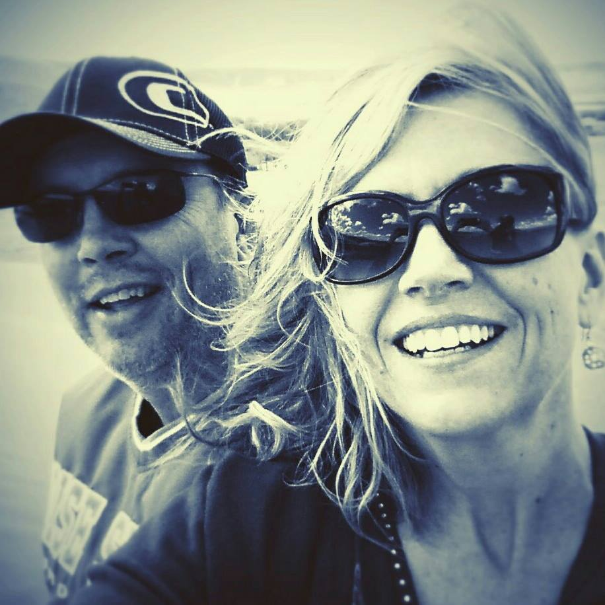
Jessica Piper, NNU
Has four grandkids
Hates pickled beets with a passion
Her first pet was a pony named Winnie
Was a rodeo queen

Slide 3
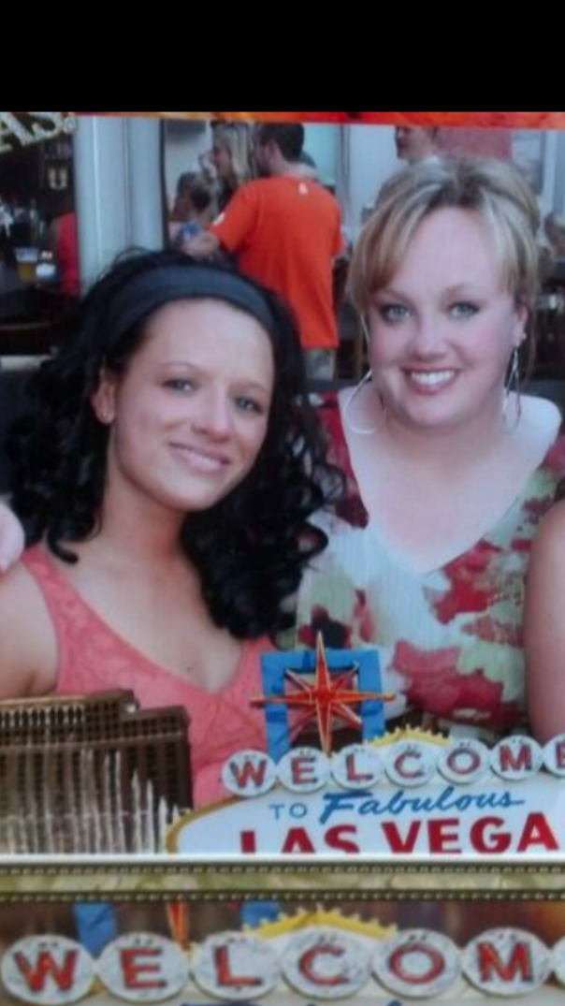
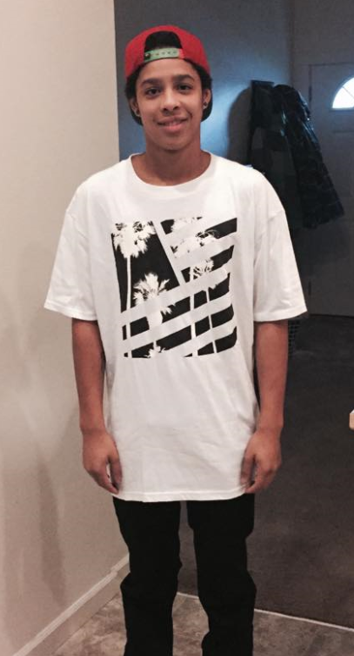
Trisha Madsen, NIC
Teaches fitness classes
Has a 16 year old son
Loves history, fantasy, and science fiction
Favorite way to eat a potato: French fries!
Financial Aid Advisor at NIC

Slide 4
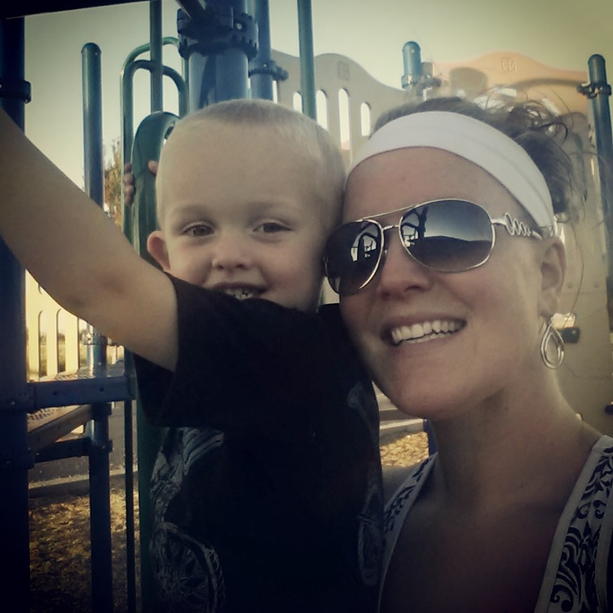
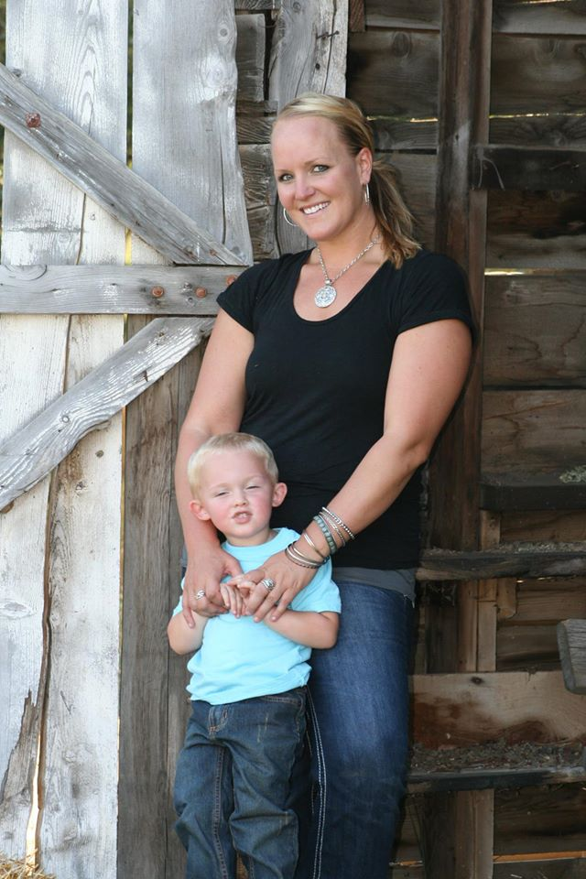
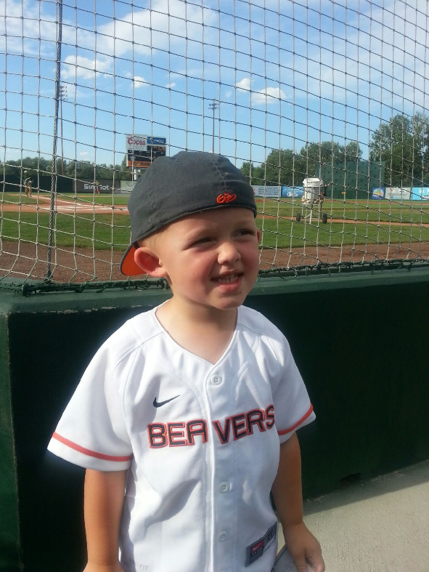
Stephanie Petersen, CWI
Was raised on a dairy farm
Coaches youth softball
Taught English in orphanages in the Dominican Republic
Went to school in Denmark during her undergrad
Financial Aid Coordinator at CWI

Slide 5
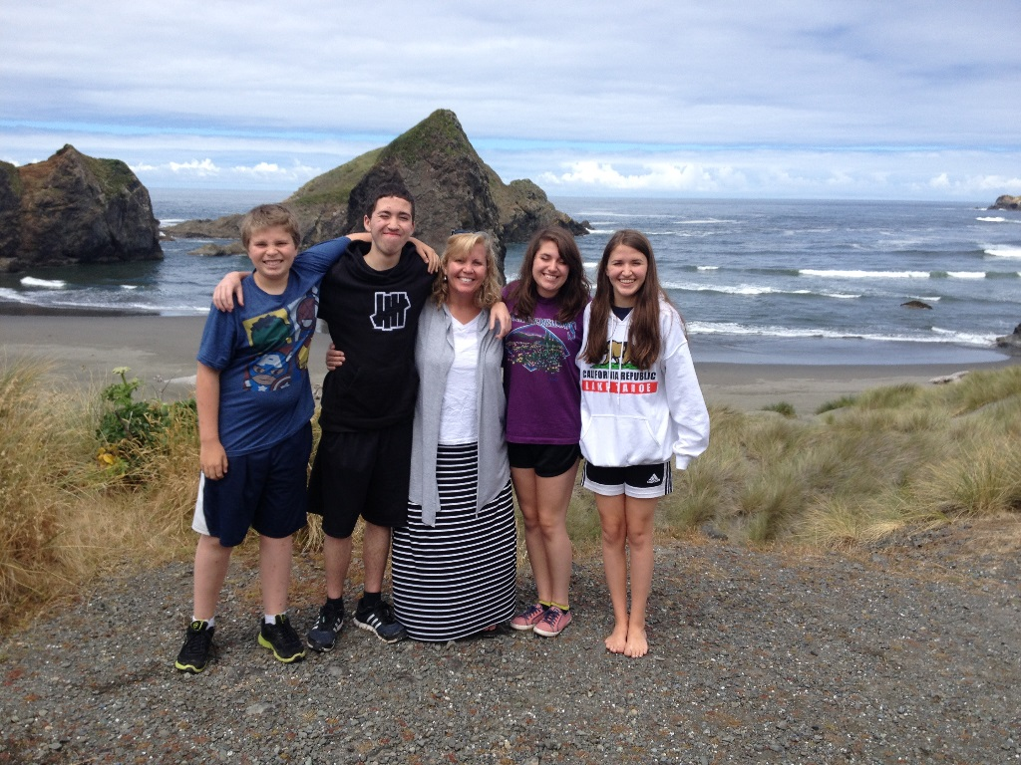
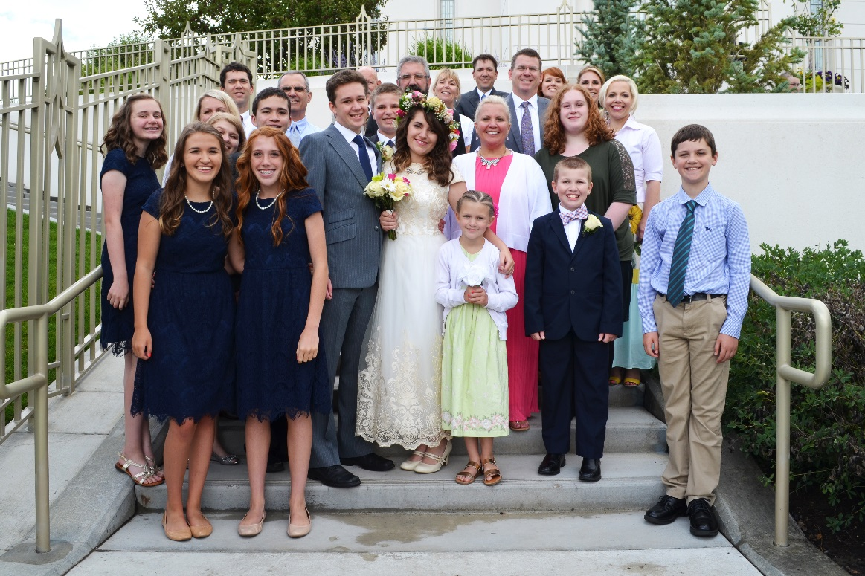
Alisa Fye, BYU-I
Used to be a litigation attorney
Skied competitively in college
Had dinner with Neil Armstrong
Financial Aid Counseling Manager at BYU-I

Slide 6
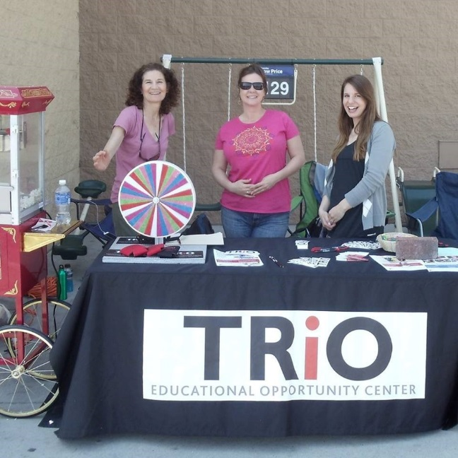
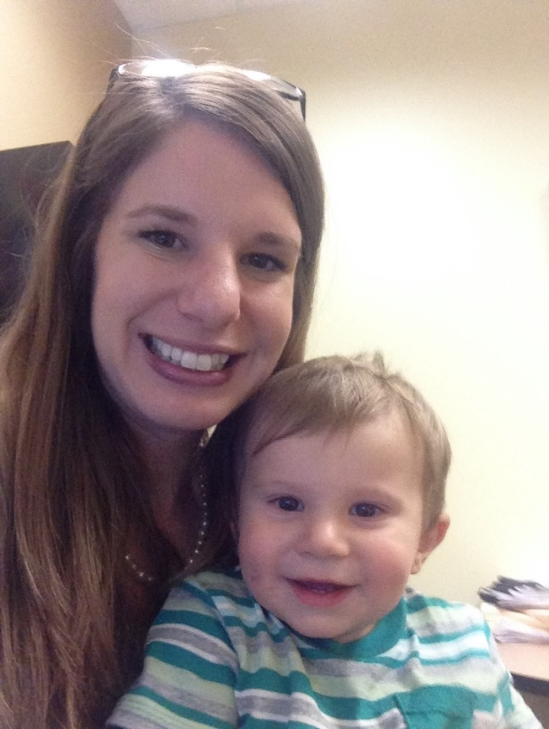
Kaitlin Brookshire, TRiO
Pineapples are her most favorite thing in the world
Believes ants could take over the world (1 human: 1.6 millions ants)!
Wishes she lived in Scotland so she can claim the unicorn as her national animal
Educational Specialist at the University of Idaho, TRiO

Slide 7
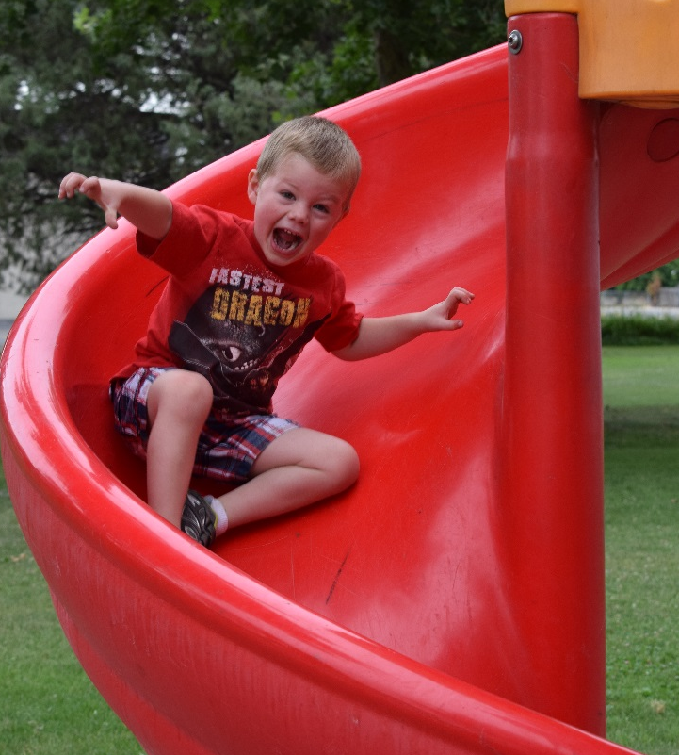
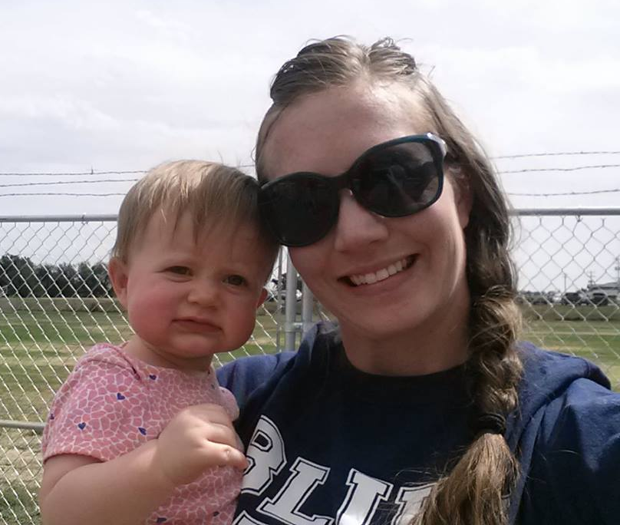
Jessica Smith, CWI
Is a competitive team roper
Wants to be a professional photographer some day
Took the picture you see as the backdrop!
Loves hunting and camping
Financial Aid Manager at CWI

Slide 8
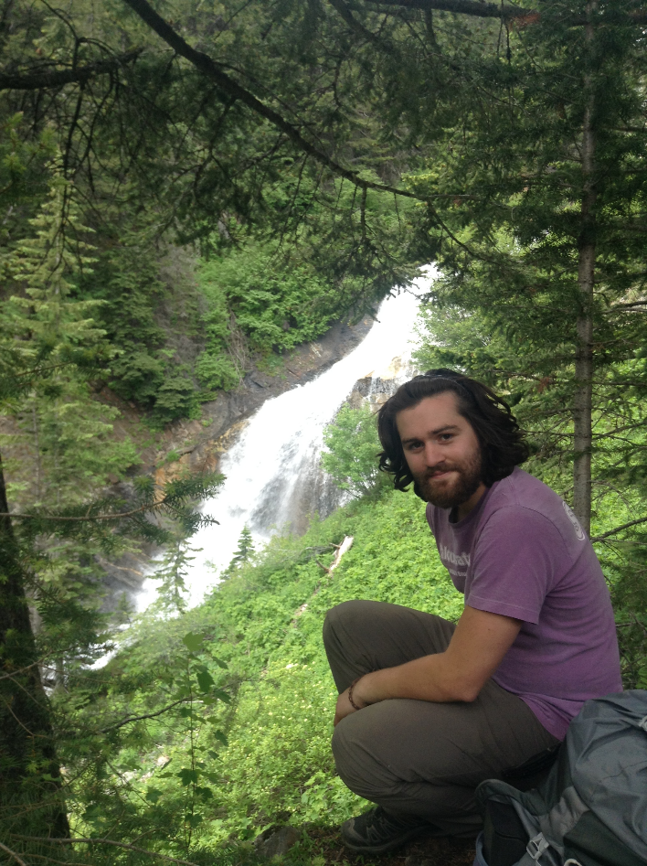
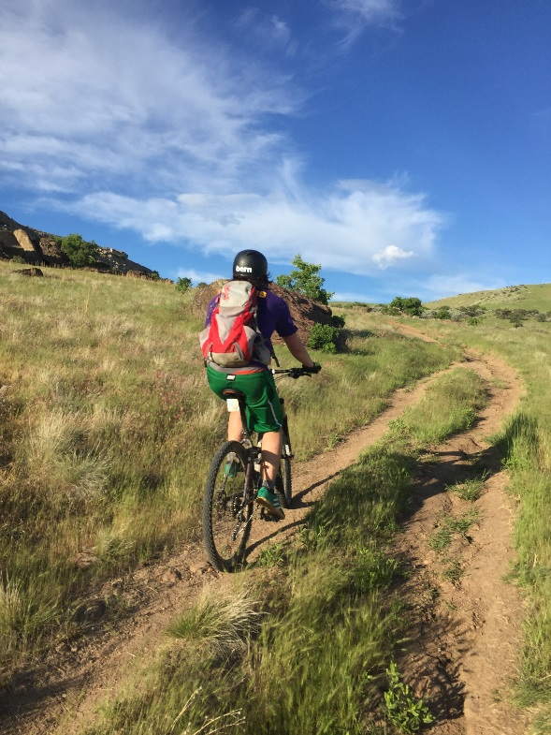
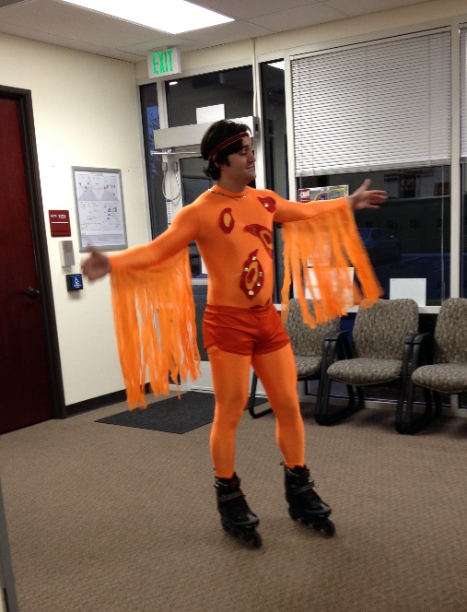
Daniel Lemus, CWI
Lived in Getxo, Spain for 6 months
Had deformed Eustachian tubes while growing up
Winking faces in work IM’s make him uncomfortable
Financial Aid Advisor at CWI

Slide 9
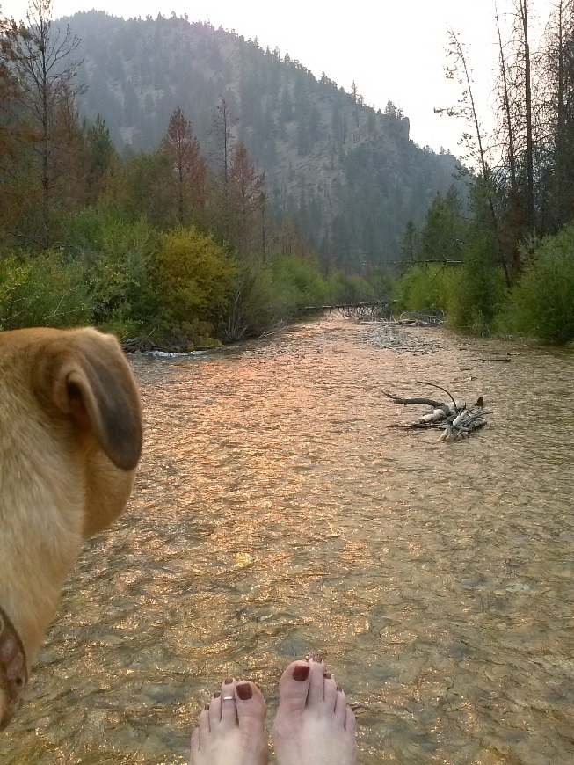
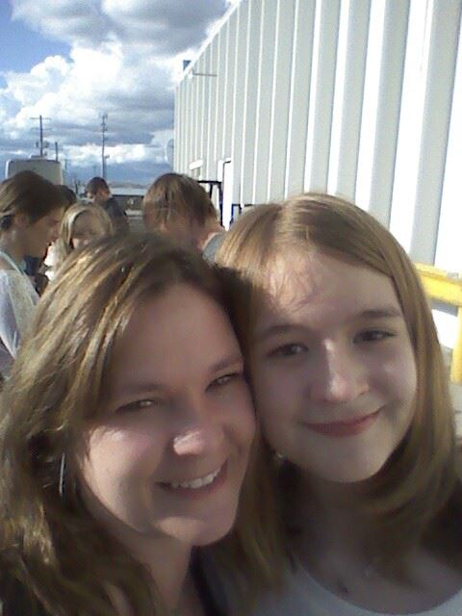
Holly Kimbrell, TRiO
Studied basic oceanography in Monterey, California
Enjoys yoga
Loves storms and listening to the rain
Educational Specialist with TRiO

Slide 10
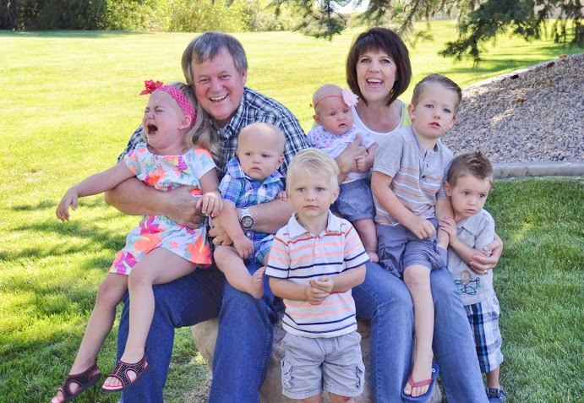
Suzanne Williams, BYU-I
Was born and raised in the first city in the world to be lit by atomic energy
Walked in front of Clint Eastwood’s car and made him wait for her to cross the road
Always has a supply of chocolate milk at her house, making her the favorite Grandma
Financial Aid Counselor at BYU-I

Slide 11
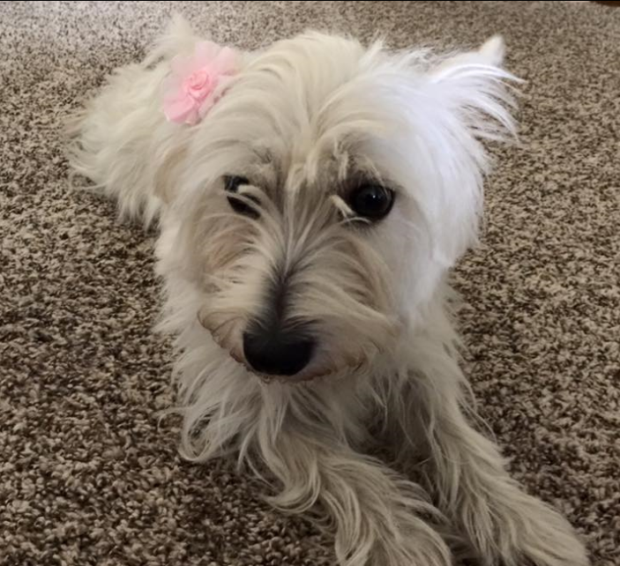
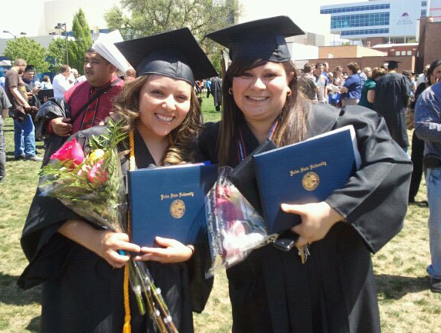
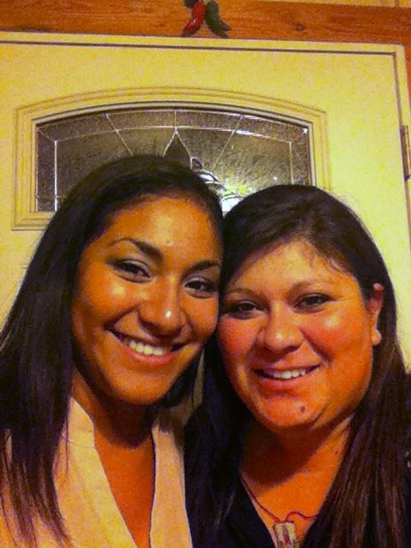
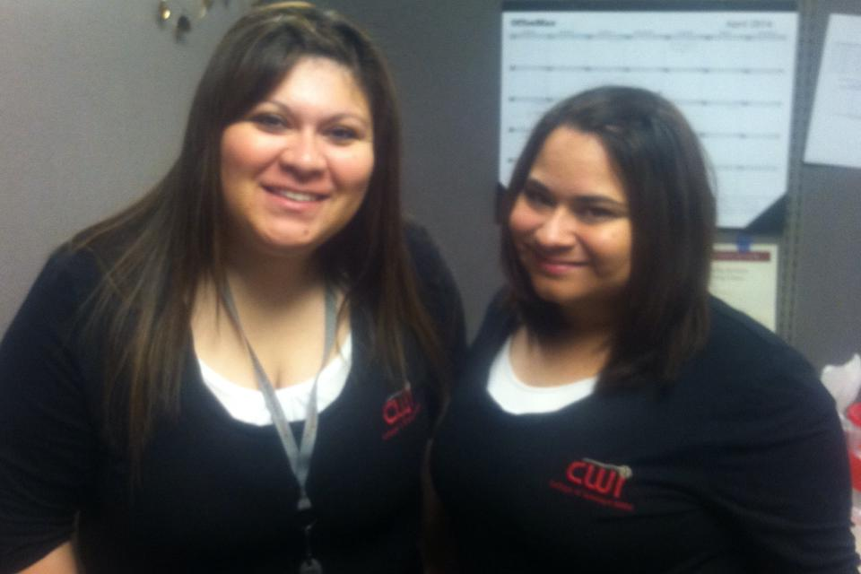
Elizabeth Ortiz, CWI
Oldest grandchild of 40 on her father’s side
Has 14 piercings total
Participated in a summer immersion program to Tijuana and Southern California while attending BSU
Financial Aid Specialist at CWI

Slide 12
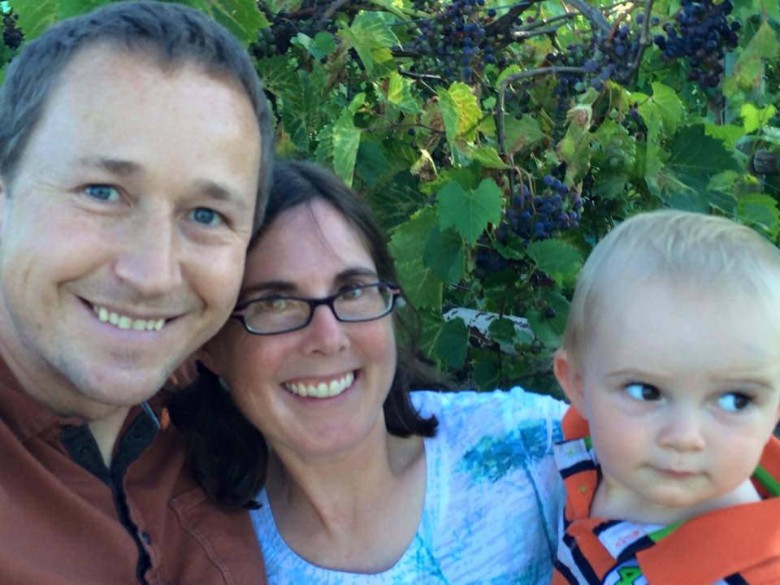
Lyssa Thaden, ASA
Has hiked to the bottom of the Grand Canyon
Plays the flute
Home made bread is her house specialty
Manager of Partner Education at American Student Assistance

Slide 13
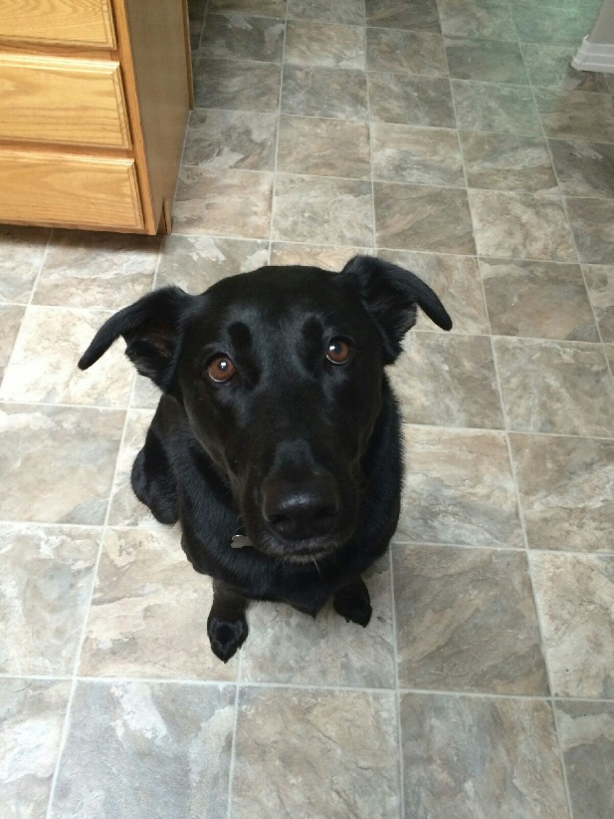
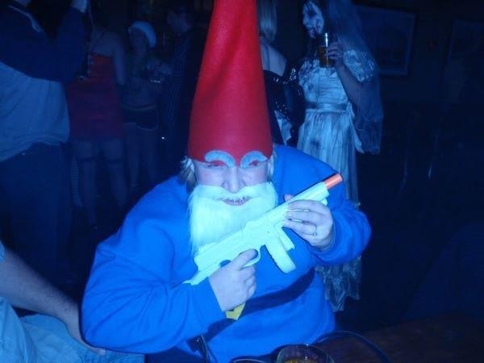
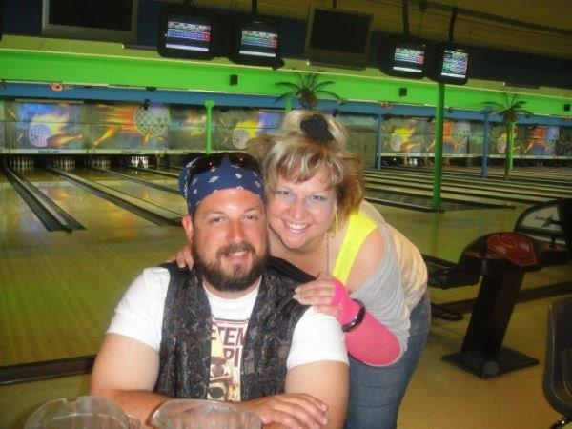
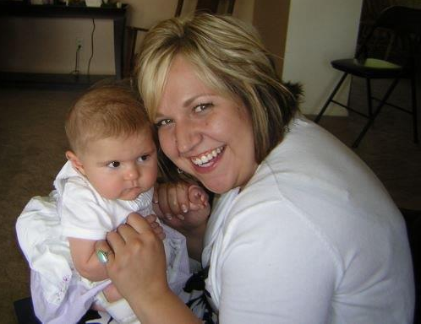
Michelle Haviland, CWI
Hopes to play Plinko on the Price is Right before she dies
Wants to be an event planner when she grows up
Loves 80’s Hair Bands
Financial Aid Manager at CWI

Slide 14
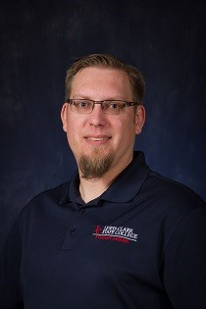
John Bender, LCSC
Has ridden a motorcycle through every state west of the Rocky Mountains
Recently purchased a chunk of land to create his own private campground
Owns a small fleet of classic cars
Once ate an entire pizza (box and all) to satisfy a $2 bet
Program Coordinator at LCSC

Slide 15
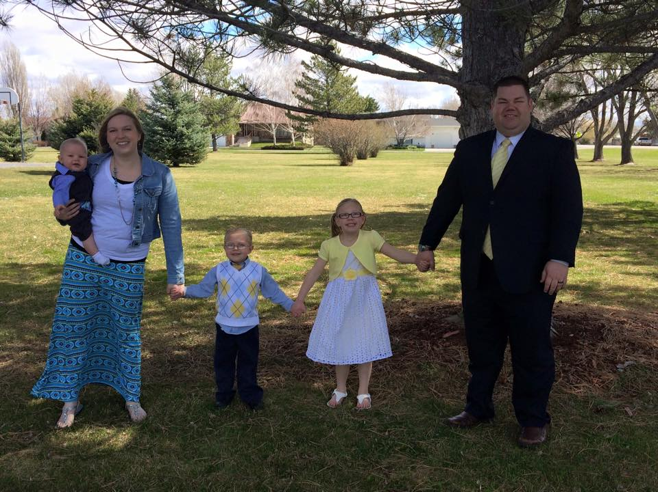
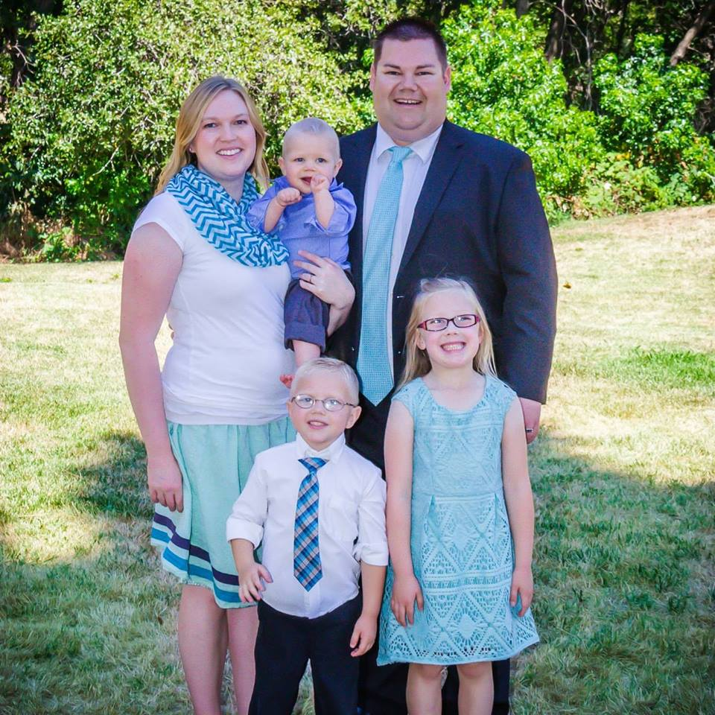
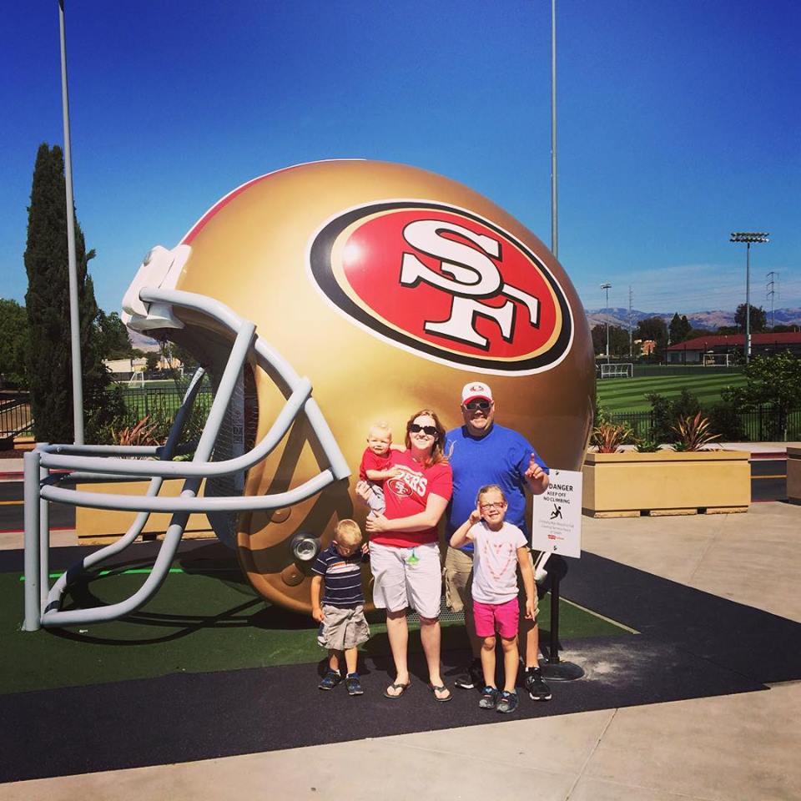
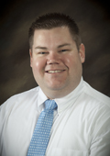
Rod McGrath, BYU-Idaho
Coached youth football for 5 years and played semi-pro football for 2 years.
Is a PADI Advanced SCUBA diver.
Was once part of a clogging ensemble
Was known as the “Carlton” dancer in high school
Processing and Operations Manager at BYU-Idaho

Slide 16
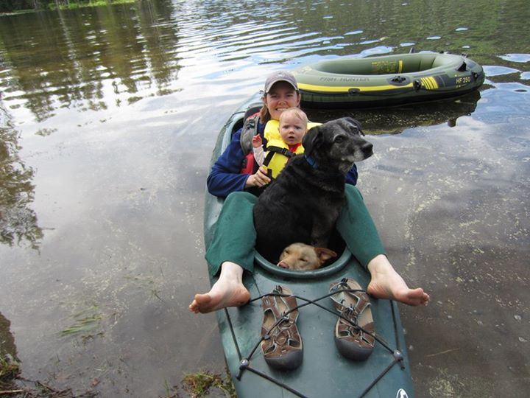
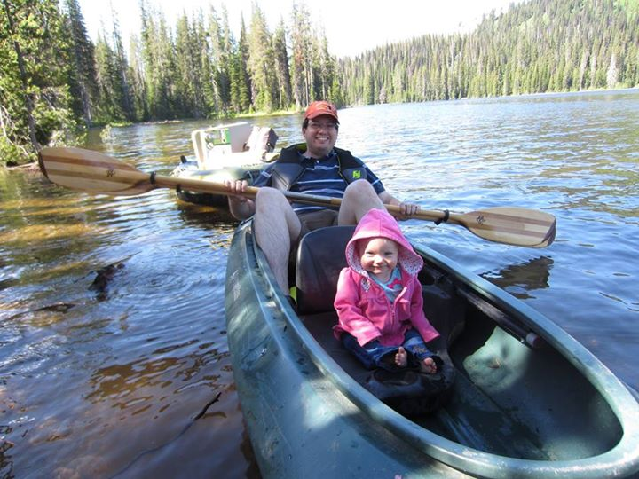
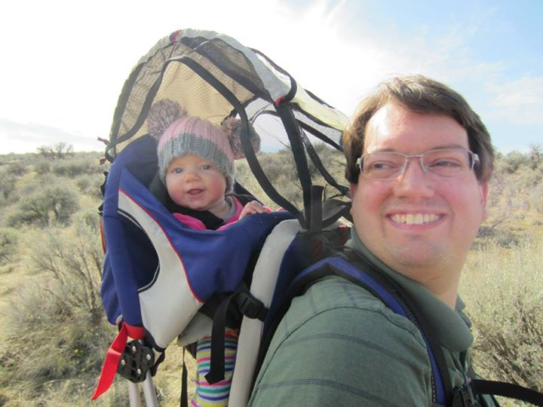
Ben Bishop, CWI
Loves camping and kayaking
Hosts monthly board game nights
Has a one year old and one on the way
Financial Aid Advisor at CWI

Slide 17
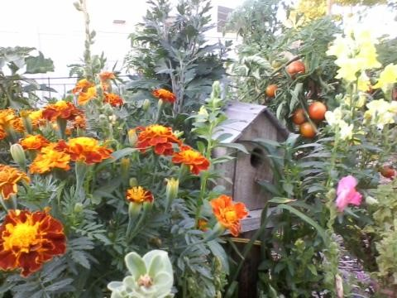
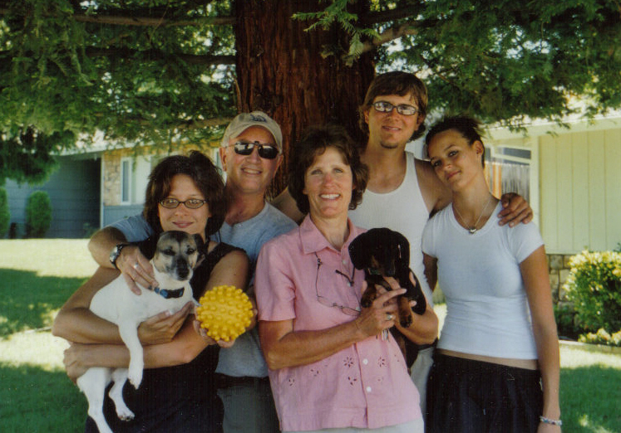
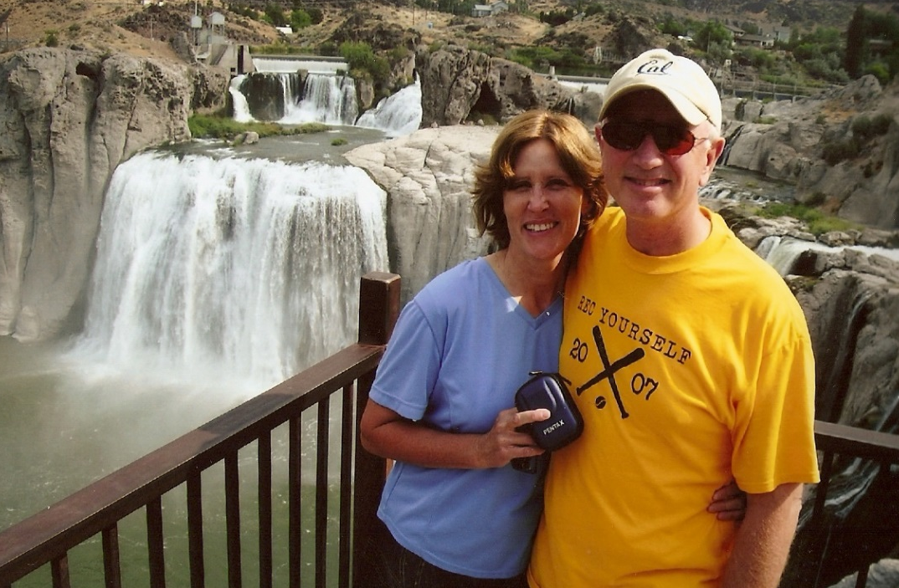
Jeff McKinnis, CWI
The surgeon that delivered him was a silver medalist in the high jump in the 1920 Olympics
Worked as the Mill Superintendent for the Yellow Jacket gold mine in the Mother Lode of the Northern California foothills
Collected and deposited two checks (for his company at the time) in the same day totaling $7.5 million
Financial Aid Advisor at CWI

Slide 18
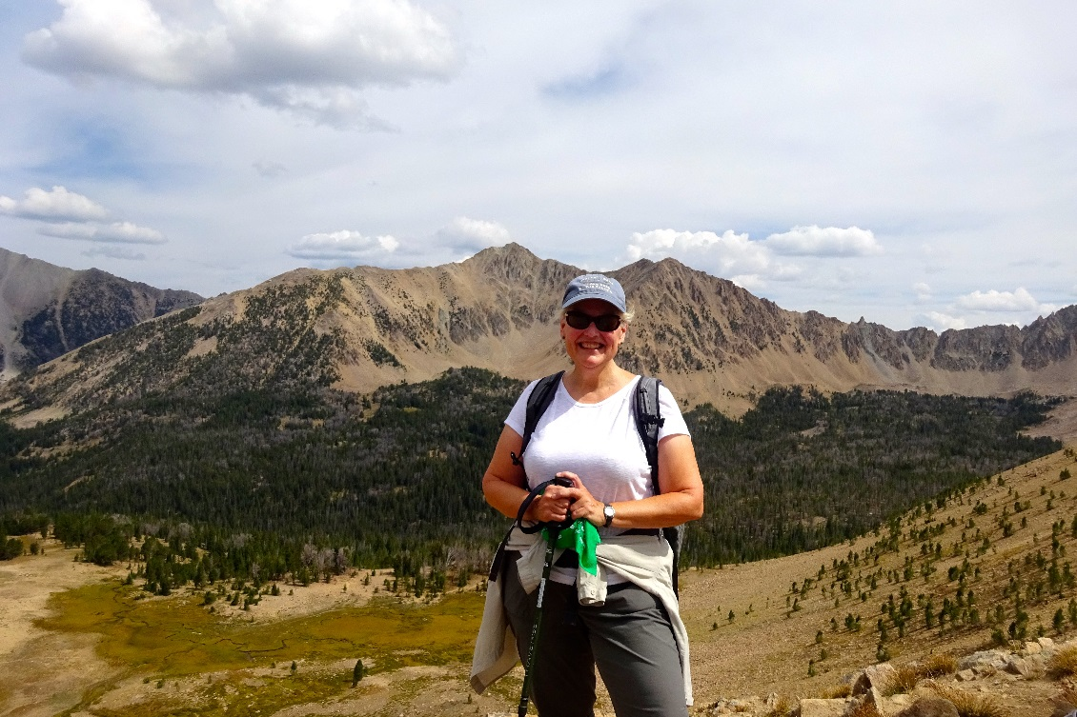
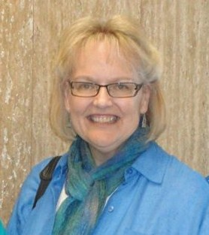
Marty Payne, BSU
Lived on the Salmon River in a log cabin for 1.5 years and survived the 6.9 earthquake in 1983- the largest recorded earthquake in Idaho
Is a 5th generation native Texan
Once worked for the (then) second largest law firm in the U.S.
Compliance Office at BSU

Slide 19
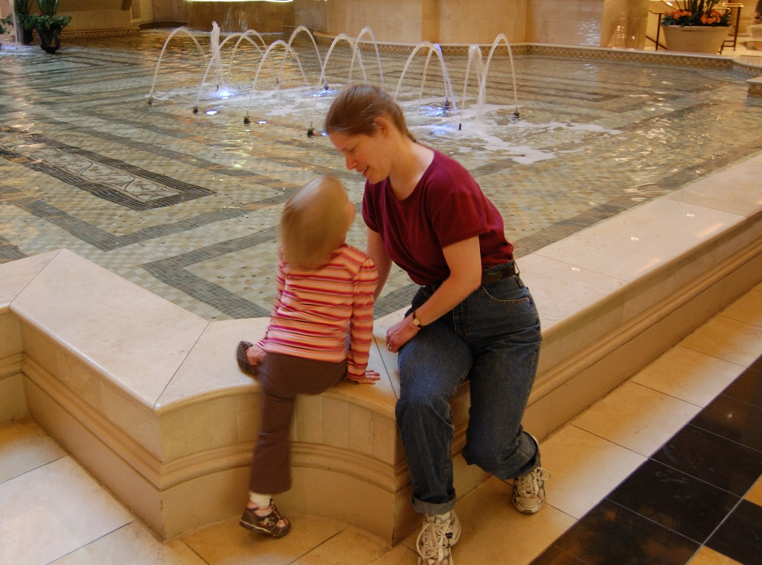
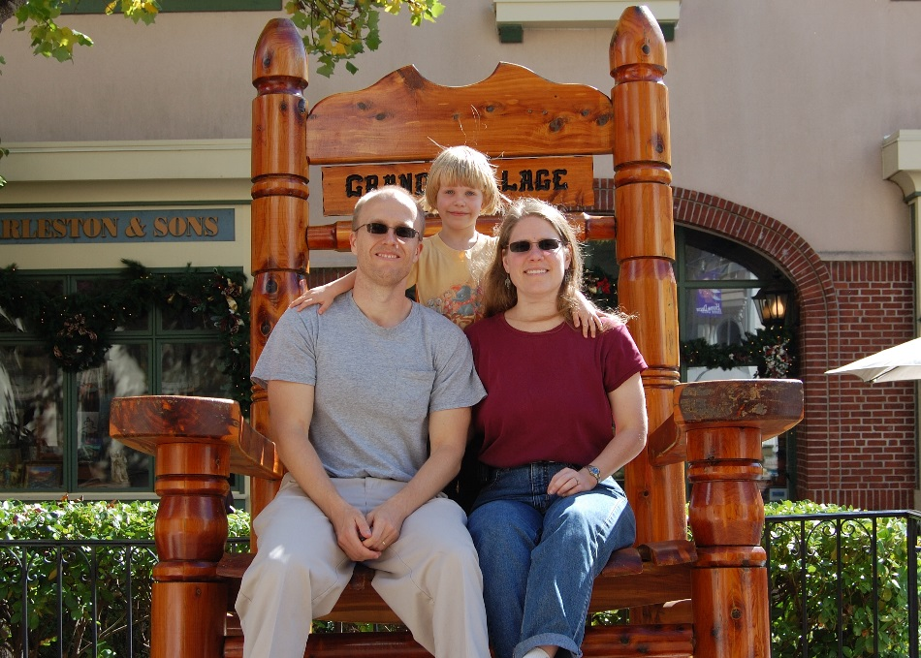
Leslie Hammes, U of I
Trained Muay Thai in her 20’s
Was in 4-H in middle school
Was a girl scout for over 10 years
Associate Director at U of I

Slide 20
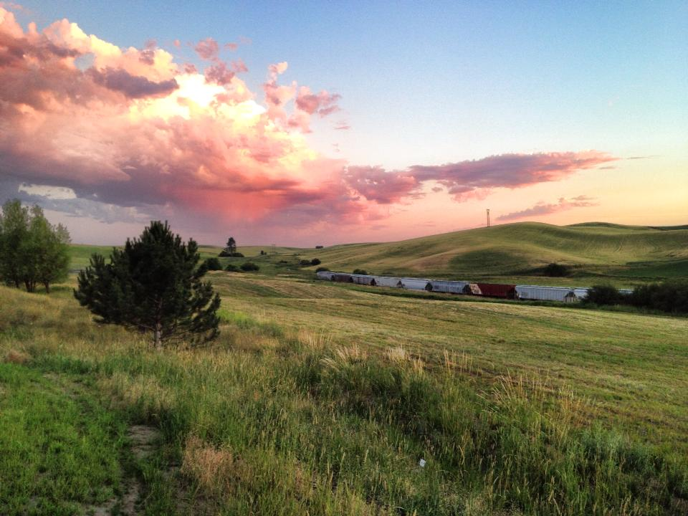
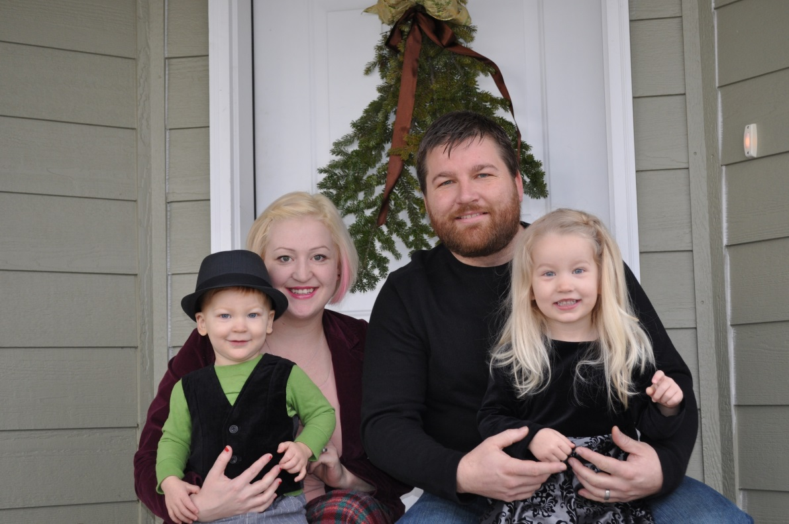
Michael Placke, U of I
Once cooked in a restaurant for Keifer Sutherland and Penn from Penn and Teller
Has a peach orchard and doesn’t like to eat peaches
Financial Aid Counselor at the University of Idaho

Slide 21
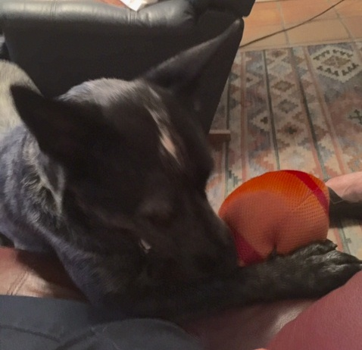
Diana Fairchild, BSU
The greatest vacation in her life was a bicycle trip along the Normandy/Brittany coast
Her entire fall calendar revolves around BSU Football
Has worked at BSU for more than 30 years
Director of Financial Aid & Scholarships at BSU

Slide 22
Laura Hughes, LCSC
Has had stitches in her tongue
Milked a cow twice a day as a child
Has finished Bloomsday twice with her daughter
Director of Financial Aid at LCSC

Slide 23
Kevin Hiller, CWI
Has a seven week old son
Used to play the piano
Worked in the prison as a Corrections Officer before coming to higher education
Financial Aid Advisor at CWI

Slide 24
Sun Ow, Great Lakes
Was featured in an HGTV room makeover show
Was a teacher in China, near Shanghai
Currently volunteers at a Marine Mammal Rescue center

Slide 25
Julia Putnam, C of I
Has only been camping one time
Would love to own enough land to give senior dogs in the pound a place to spend their last days
Wants to be a dance instructor
Has drag raced at Firebird Raceway

Slide 26
Charity Strong, Carrington
Won second place as Boise’s Best Bad Dancer in 2013
Her favorite part about college football is the implicit math used for ranking.
She loves to color
Regional Manager for Carrington

Slide 27
Jenee Snyder, CWI
She’s related to Dick Clark (American Bandstand)
Attended seven different schools from 1st- 12th grade
Comes from Amish heritage
Financial Aid Manager at CWI

Slide 28
Ally Daniels, BSU
Spent six months in Florence, Italy studying abroad
Considers herself a gelato connoisseur
This summer she got married, bought a house, and vacationed in Hawaii in a span of 2 ½ weeks!
Financial Aid Counselor at BSU

Slide 29
Nicole McMillin, CWI
Didn’t start snowboarding until she was 35
Played tennis in college
Competed in and judged pageants
Is a master morel mushroom hunter
Was part of a puppet team

Slide 30
Ann Crabb, NNU
Married her husband to genetically modify her children (he’s 14 inches taller!)
Her dog was a monthly model for the Idaho Human Society calendar this year
Loves to hike in the forest
Director of Financial Aid at NNU

Slide 31
Michael Wilson, BYU-I
Loves numbers and analyzing them
Enjoys board games like Settlers of Catan, Monopoly, Risk, etc.
Is an intense Christmas decorator
Eligibility Specialist at BYU-I

Slide 32
Sylvia Turley, BYU-I
Was once a government contractor where she held an explosive certification
Was once a mountain climber, but now only occasionally sport climbs
Likes to design and create quilts for her grandchildren
Financial Aid Counselor at BYU-I

Slide 33
Merna Davis, C of I
Is a grandma
Her parents recently lost almost everything due to wildfire
Financial Aid Specialist at C of I

Slide 34
Aaron Sans, BYU-I
Was a TV host/ news anchor/ reporter for a weekly local county/ school district new program
Was once a probation officer and member of a gang taskforce
Was in New York on THE 9/11
Before moving to Idaho, he lived in the 9th and 11th largest uban areas in the world, each one having 20 million people

Slide 35
Stephen Field, NNU
Thinks basketball is the greatest of all sports
Loves to read Jack Reacher books
His favorite candy is peach rings
Loan Processor/Office Manager at NNU

Slide 36
James Martin, ISU
Was once a welder
Owns a saddle, but no horse
Is soon to be the proud parent of a U of I alumni!
Director of Financial Aid at ISU

Slide 37
Connie Solis-Garcia, BSU
Loves making cards and mini albums
English is not her first language
Financial Aid Counselor at BSU

Slide 38
Terri Scott, C of I
Has been married 35 years
Has three grandchildren
Loves shoes
Loves to hike
Assistant Director of Student Financial Aid at the College of Idaho

Slide 39
JoAnna Velasquez, CWI
Makes the best lasagna in the world according to her son Felix
Her son loves food and is a great little chef
Financial Aid Specialist at CWI

Slide 40
Daniel Carlos, U of I
Was a movie extra for two years
His first language is Spanish
Was an avid skateboarder until he broke his ankle
Financial Aid Counselor at U of I

