Slide 1
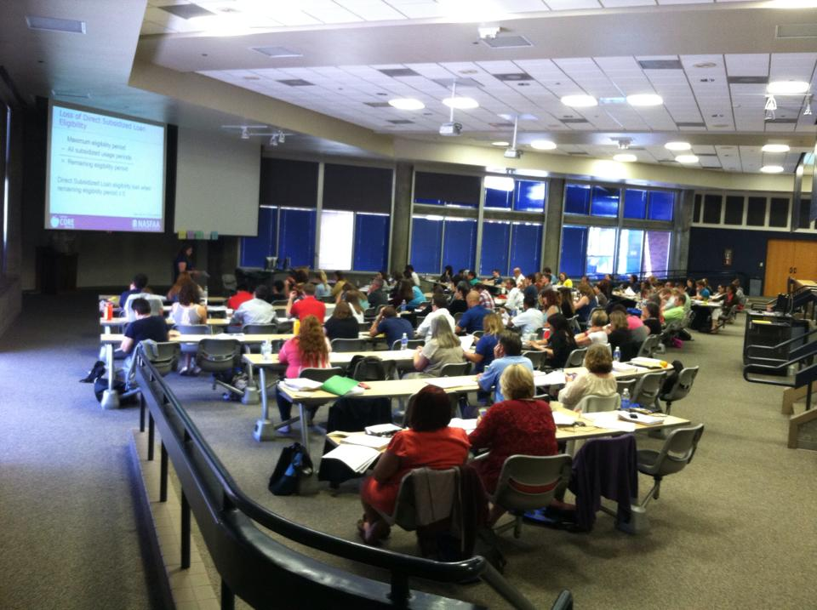
Doing Financial Aid Presentations: A Philosophical and Practical Approach
Mike Johnson, Director of Student Financial Aid & Scholarships, Portland State University;
2016-17 WASFAA President

Slide 2
How is your comfort level?
Do you:
think you have inadequate knowledge?
have limited experience with public speaking?
fear public speaking?
fear the unknown?
fear people?
compare yourself unfavorably to good presenters you’ve heard?

Slide 3
What would help you be more comfortable?
Having:
more knowledge?
more experience?
more confidence?
less fear?
Let’s see what we can do to help

Slide 4
Some ideas you may find useful
Preparation Approaches
The Ray Bradbury
The Hal Holbrook

Slide 5
Some ideas you may find useful
Presentation Approaches
The Jason Day
The Chesley Sullenberger

Slide 6
Preparation approaches
The Ray Bradbury
You likely know more than you think you do.
You almost certainly know more than the audience does.
The Hal Holbrook
Draw on your knowledge as needed.
You’ll be ready for anything.

Slide 7
Preparation: the practical stuff
Understand the topic
Get as much information as possible from the people who invited you. Find out how much time has been allotted.
Understand the audience
Size, demographics, and expectations all affect what you should say and how you should say it.
Understand the venue
The size and shape of the room, its acoustics, and it’s lighting can affect how you present.

Slide 8
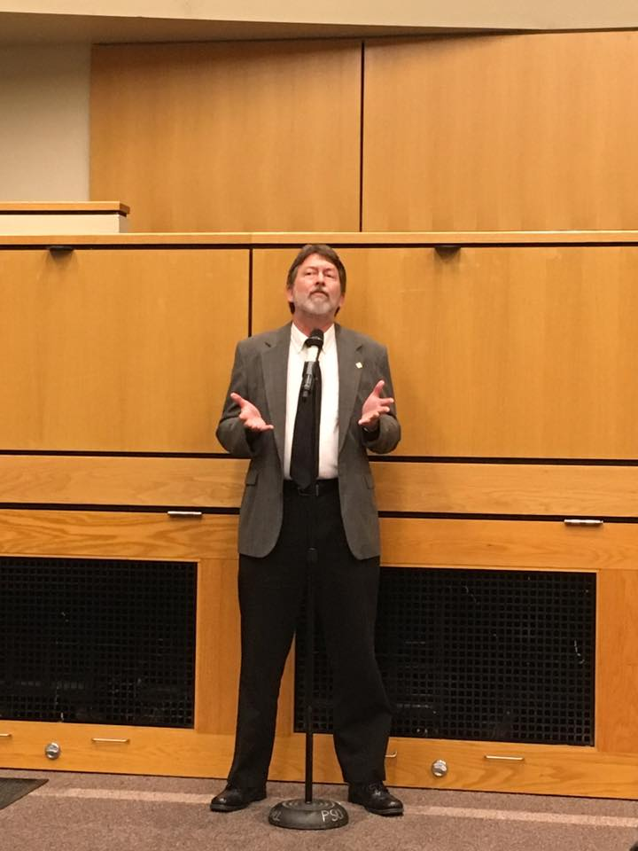
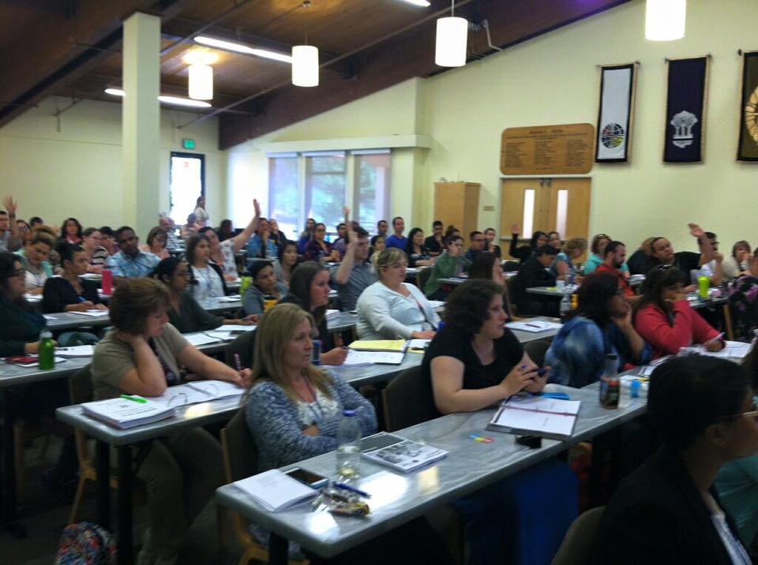
Presentation approaches
The Jason Day
Visualize your presentation.
You may almost feel as if you’re repeating it.
The Chesley Sullenberger
Stay in the moment.
Provides focus, improves performance.

Slide 9
Presentation: the practical stuff
Understand your knowledge and comfort levels
Short-term: play to the former.
Long-term: improve the latter.
Understand your strengths and weaknesses
… and work with them.
Understand your preferences
Formats (lecture/discussion, high tech/low tech) can facilitate a successful presentation.

Slide 10
A visual heuristic: “cone of knowledge”

Slide 11
A visual heuristic: “cone of knowledge”

Slide 12
Example content: surface
Federal Methodology
Federal formula for determining Expected Family Contribution (EFC) from FAFSA data.
The EFC is subtracted from the Cost of Attendance (COA) to determine applicant’s “need”.

Slide 13
Example content: shallow
Federal Methodology
Federal formula for determining Expected Family Contribution (EFC).
There are different models for dependent students and independent students.
There are simplified formulas for students and parents who don’t file taxes or who have simple tax filing statuses.

Slide 14
Example content: deep
Federal Methodology
Federal formula for determining Expected Family Contribution (EFC).
From Title IV, Part F of Higher Education Act of 1965.
Three models:
Dependent
Independent without dependents other than a spouse
Independent with dependents other than a spouse
Three variants (not all variants apply to all models):
Regular
Simplified Needs Test
Auto-Zero

Slide 15
Discussion and Questions

